Slide 2
Sustainable materials: which plastic?

Slide 3
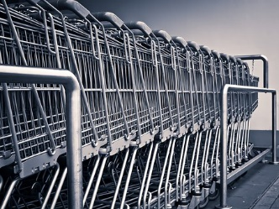
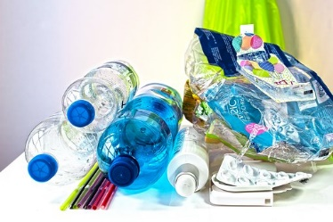
Which material is the odd one out and why?
Notes:
Odd one out activities should promote thinking and discussion. Children should be encouraged to offer suggestions and possibilities, secure in the knowledge that there is absolutely no definite correct or incorrect answer to the question. Ask children to suggest as many different responses as they can and give reasons for each one, for example: metal because it is not transparent but glass and plastic are, metal because you can’t make a bottle out of it but you can have plastic and glass bottles, glass because it can smash easily, metal because it conducts electricity etc. Odd one out activities are a great way to discover what children already know about a subject matter and also to uncover children’s misconceptions about science, in this case about materials.

Slide 4
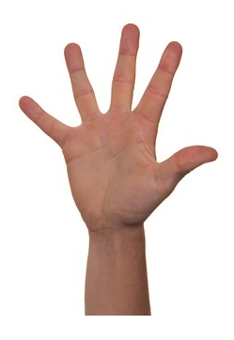
Which objects made from plastic do we use in our lives every day?
Why are so many things made out of plastic?
List 5 reasons why plastic is fantastic . . .
Notes:
Collect suggestions from the class and discuss how almost everything around us can be made from plastic, with reference to its properties, such as: it is lightweight, low in cost, durable can be moulded, shaped and coloured into almost any object and is also long lasting.

Slide 5
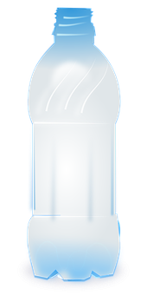
Does plastic last forever?
Many plastics are practically non-degradable , which means that they remain in excellent condition for a long time.
It could take up to 1000 years for a plastic bag to degrade.
It could take up to 450 years for a plastic bottle to rot away.
It could take more than 250 years for a baby’s nappy to decompose.
Notes:
Children should continue to think about the sustainability of plastic. Explain that many plastics are practically non-degradable , which means that they remain in excellent condition for long periods of time. It could take many years for certain types of plastics to rot away or degrade! Discuss how, with an increasing focus on protecting he environment, scientists and engineers are designing plastics that will disappear much more quickly. The main examples of these are bioplastics made from natural materials such as corn starch or sugarcane, biodegradable plastics made from traditional petrochemicals, which are engineered to break down more quickly, and eco/recycled plastics, which are simply plastics made from recycled plastic materials rather than raw petrochemicals. Explain that many household and business products are now being manufactured using biodegradable plastics, such as:
Foam packaging, which includes starch-based loose-fill packaging — packing peanuts
Mulch sheeting for gardening / agriculture
Paper coatings for cups and cartons
Textiles and nonwoven fabrics
Medical devices such as sutures and implants
Downhole tools for oil and gas field operations
3-D printing filament
Discuss how biodegradable plastics have specific uses, such as for the products listed above, however would be no good in items such as window frames!!

Slide 6
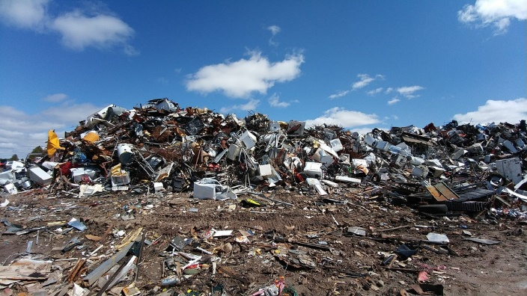
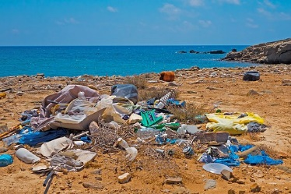
Where does all the plastic go?
How can this have a negative impact on the environment?
landfill
litter and ocean pollution
Notes:
Ask the children to think about what happens to plastic objects once they are no longer needed and what impact this might have on our environment.
Discuss how a huge amount of plastic is buried in landfill sites where it eventually breaks down into tiny particles that can pollute our soil and water. Many plastic items are also often left in the natural environment as litter, which could end up as pollution in the oceans.

Slide 7
What do you think can be done to reduce the amount of plastic
items sent to landfill or ending up as litter pollution?
Reduce
What does this symbol mean?
Do you know what the 3 R’s are?
Recycle
Reuse
Can all types of plastic be used again? Why do you think this?
Notes:
Conclude with the children that the best outcome to increase the sustainability of plastic is to reduce the amount of plastics we use or, for a plastic item that has been used, is for it to be reused or recycled into a new product to be used again as many times as possible. However, explain that not all plastics can be recycled easily. Explain that there are ‘low grade’ plastics that are very difficult to break down at recycling plants and hard to recycle.

Slide 8
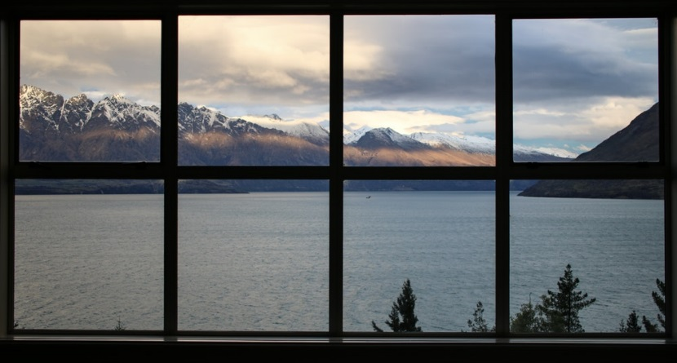
One type of plastic: PVC-U
PVC-U is used for making doors and window frames.
Compared with wood and metal, it:
is lighter
is tougher
is stronger
is more weather resistant
has better thermal insulation
lasts longer.
Many people think that PVC-U is a single-use plastic and cannot be recycled. It is thrown away when it has been used once and ends up in landfill.
Notes:
Refer back to the Introduction of the main activity and ask children which different types of plastics they can name. They should remember the name of PVC (polyvinyl chloride) - a type of plastic met in the ‘Which Plastic?’ main activity, used to make products such as bank cards, pipes and clear food wrapping. Explain that a version of this is called U-PVC (unplasticised PVC), also known as rigid PVC because it is commonly used for pipework, window and door frames.
Ask children what will happen to all the plastic when the frames need replacing?

Slide 9
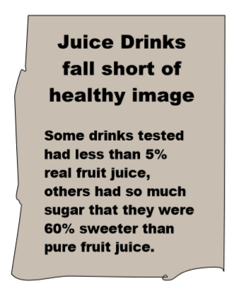
Dictionary names ‘single-use’ as the phrase of the year
There is a rising concern of how much plastic we use once and then throw away. This year has seen huge numbers of businesses pledging to phase out single-use plastics from their operations.
Some governments are preparing to ban plastic straws, cotton buds, and other single-use plastics . . . .
Notes:
This newspaper headline and information can be used as a stimulus for Introductory Activity 1b. Environmental Vocabulary (see page 6 of Teachers’ Notes). Explore children’s current understanding of the phrase ‘single-use’ and ask for every day examples of this before continuing to Activity Sheet 2 (page 8 of Teachers’ Notes).
The slide can also be used as a recap of the phrase ‘single-use’ during Activity 3 Sustainable materials: which plastic, and should enable children to think further about how much plastic ends up in landfill or as litter pollution.

Slide 10
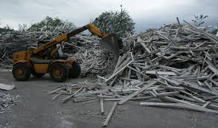
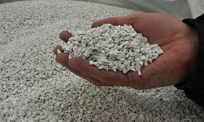
Rethinking Recycling: one company’s solution . . .
Scientists and engineers have found clever ways to reduce the amount of PVC-U that is thrown away and sent to landfill sites.
Companies are developing plastic waste recycling systems where old PVC-U frames are broken up into small pieces, cleaned, made into tiny pellets and then melted to be reformed into new window and door frames or other products.
Notes:
To watch a video about the full process explained on this slide, go to: https://www.youtube.com/watch?v=M2k7nJAO0K8

Slide 11
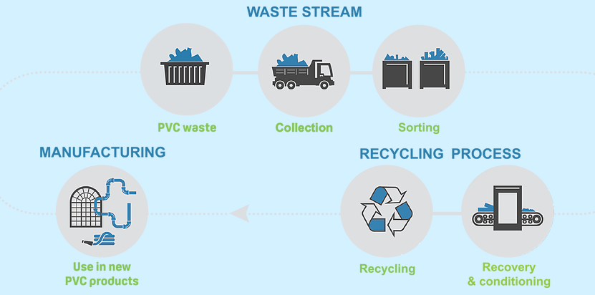
Companies, such as Inovyn at Newton Aycliffe in England, are supporting many other companies to recycle old PVC-U window frames up to 10 times without any loss of strength. This means that the same piece of PVC-U can be used for up to 350 years instead of 35 years!
Thanks to companies like this, PVC-U is no longer a single-use material and now much more sustainable. All of the old frame goes into making the new ones.
Nothing goes to waste and, more importantly, nothing is deliberately thrown away to find its way into drains, rivers and the ocean.

Slide 12
www.ciec.org.uk

